Slide 1
Diffraction
Experimental Collaboration From University of Colorado Denver
Kathryn Harris and Idriss Kacou
Associate Professor: Dr. Carlson

Slide 2

Outline
Introduction
Core Ideas
The Diffraction Pattern
The wave aspects of light
Effects of aperture width
Optical geometry and optical wavelength
The location of peaks
Fresnel (or Near) Field and Fraunhofer (or Far) Field
Other Aspects of the Light Source
Wavelength
The light source may effect a diffraction pattern
The aperture and the coherence of the source
The light intensity
Experiment
CCDs
Laser
Data Analysis
Data fitting to the curves or Newton’s method
Determining the angles of diffracted light without damaging the CCD

Slide 3

Core Ideas
The diffraction pattern
Other aspects of the light source

Slide 4


The diffraction pattern
The wave aspects of light
Effects of aperture width
Optical geometry and optical wavelength
The location of peaks
Fresnel or near field and Fraunhofer or far field
$$\frac{D}{2}\sin{θ}=\frac{λ}{2}$$
$$F=\frac{R^{2}}{Dλ}$$

Slide 5
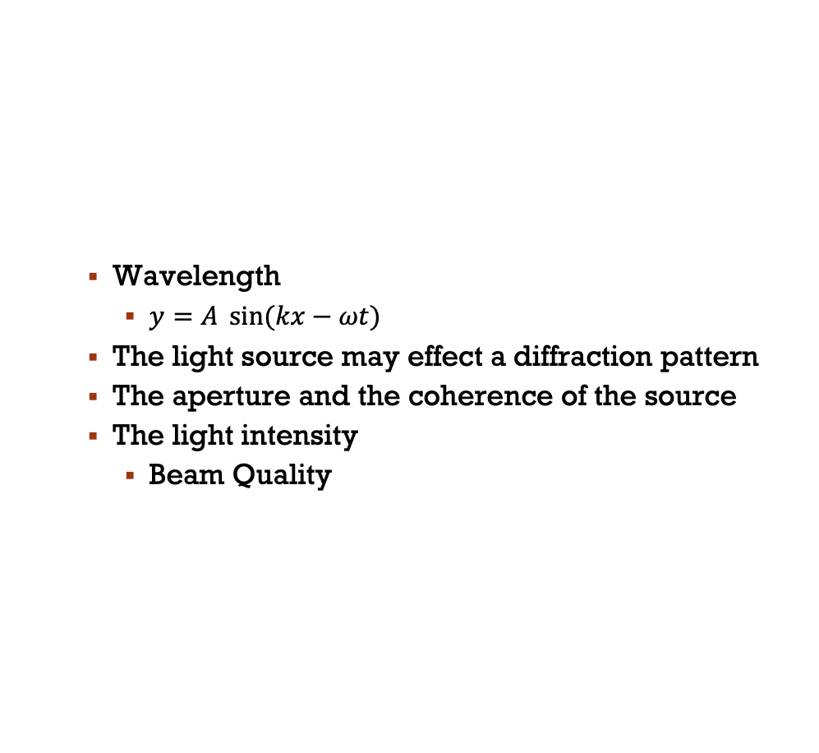
Other aspects of the light source
Wavelength
$y=A \sin{(kx−ωt)}$
The light source may effect a diffraction pattern
The aperture and the coherence of the source
The light intensity
Beam Quality
Notes:
A= 2cos(pi (d1-d2)/ wave )
Y= cos( 2pi* f* t+ phase 1) cos( 2pi*f*t+ phase2)

Slide 6
Equipment
CCD Detectors
Laser

Slide 7
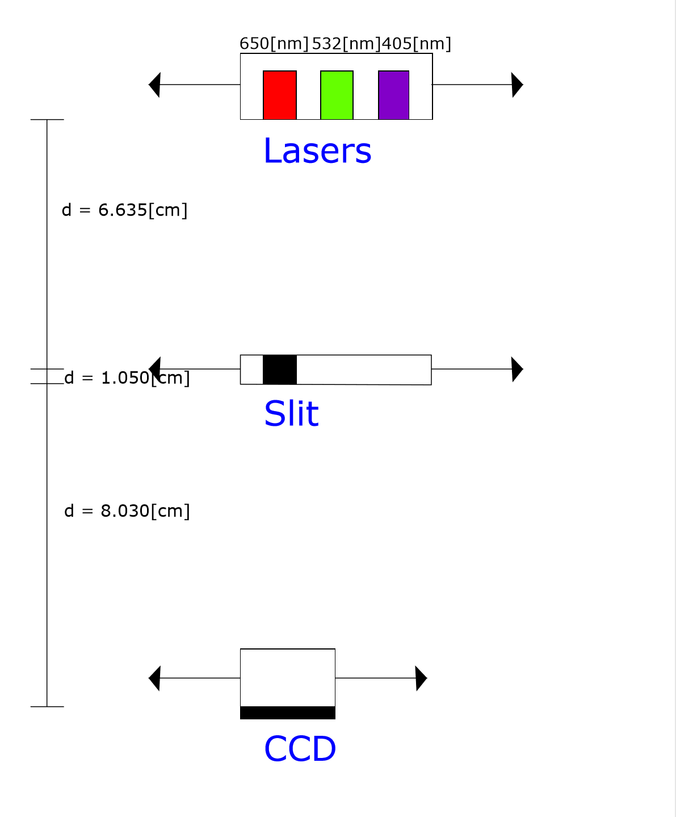

Equipment and Experimental Setup
What is not listed here is our computer setup. The CCD we used was a webcam with the lens removed; this plugged directly into the computer, which we used to operate it and save our data. This data was then translated into a matrix by MatLab, which we used to do our data analysis.
Distances were measured externally to avoid damaging any of the equipment.
Ccds
Lasers

Slide 8
CCD’s
Measure intensity of light
Multiple electrodes per pixel measure different colors
Potential wells attract electrons – more electrons at brighter regions
Quantum Efficiency
Noise – Physical damage, Thermal

Slide 9

Laser
Source which produces a very narrow beam of light
It is different from a light bulb or a flash light
Beam Quality
$I\left(r\right){=I}_{0}e^{−2{(\frac{r}{w})}^{2} }$
I= peak intensity (in the center of spot)
W= beam radius ( 1/e^2)

Slide 10

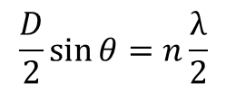
Data Analysis
Calculated Pixel Sizes using angles
Slit:/Wavelength: | 650[nm] (R) | 532[nm] (G) | 405[nm] (V)
0.04[mm] | 18[μm]±6[μm] | 29[μm]±10[μm] | 1.6[μm]±0.2[μm]
0.08[mm] | 11[μm]±3[μm] | 6.4[μm]±2.1[μm] | 1.6[μm]±0.1[μm]
0.16[mm] | 1.8[μm]±0.6[μm] | 2.4[μm]±0.9[μm] | 2.1[μm]±0.5[μm]
$$\frac{D}{2}\sin{θ}=n\frac{λ}{2}$$
Substitutes into
$$\frac{ns}{d}=sinθ$$
Which we can average to get our pixel size.

Slide 11
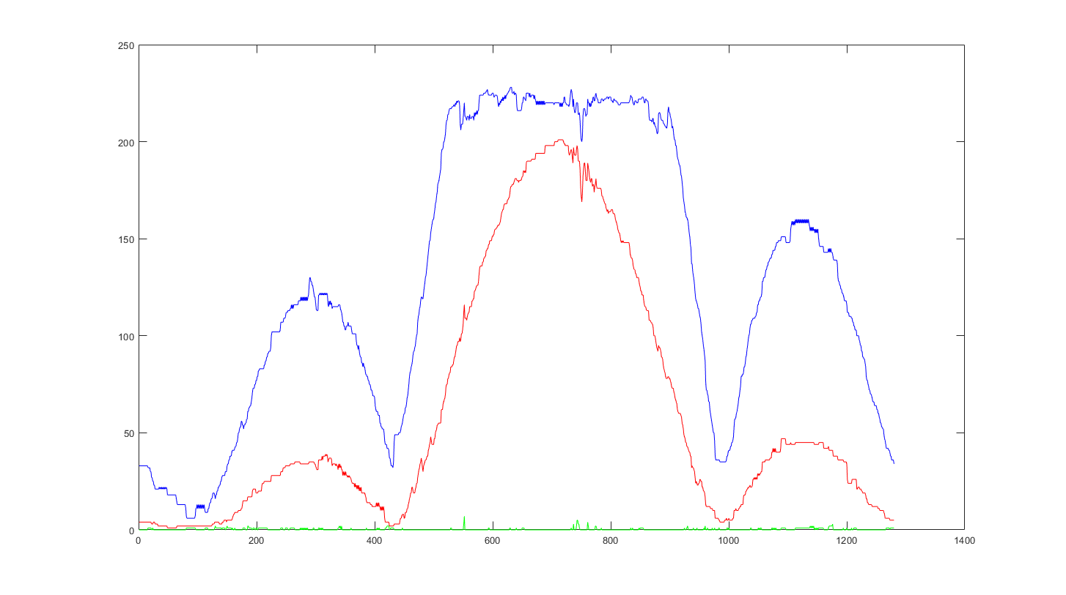
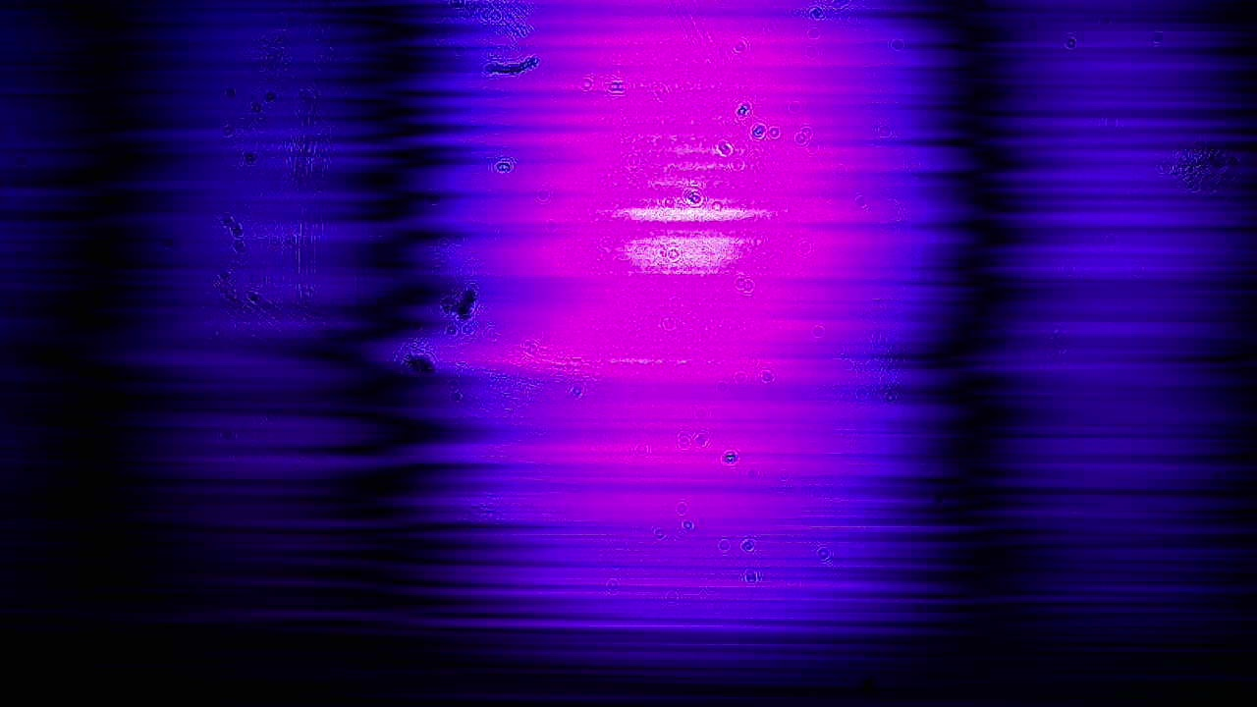
V 0.04

Slide 12
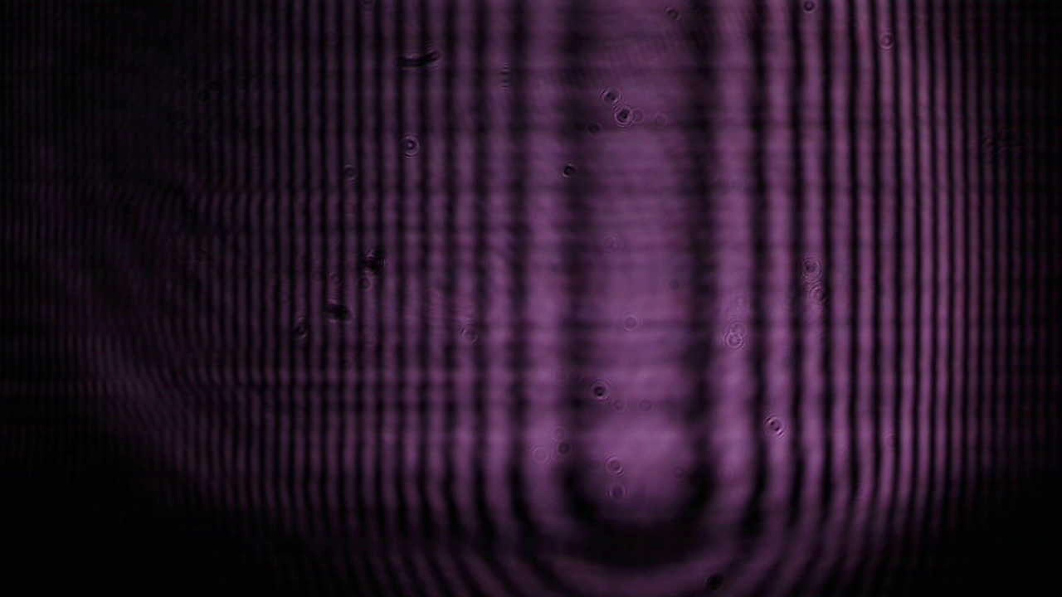
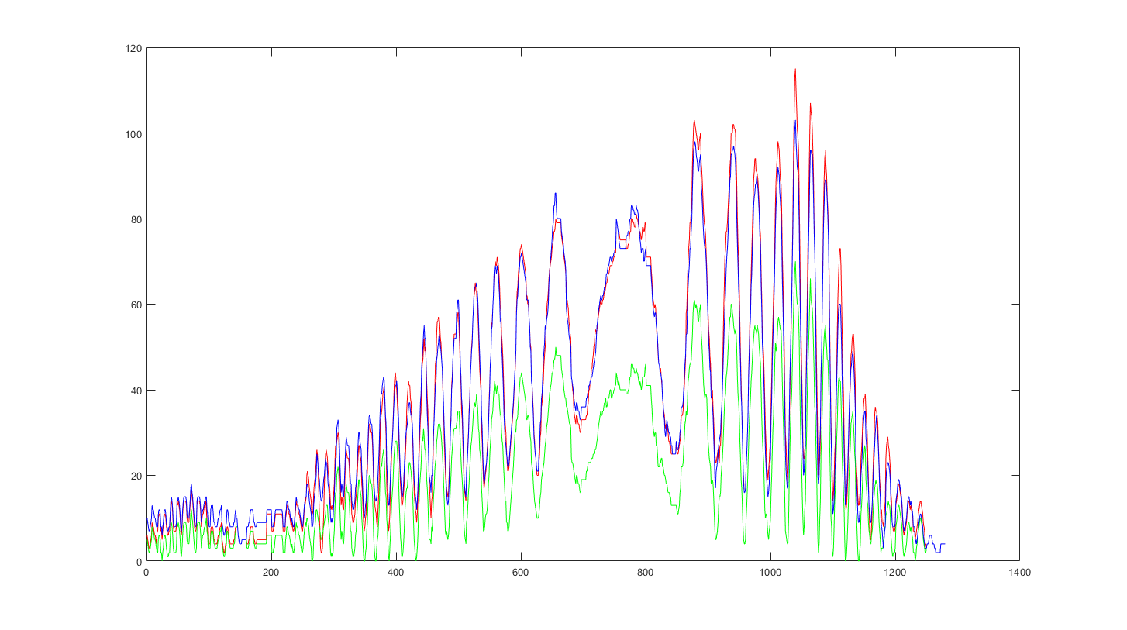
G 0.04

Slide 13
References
CCDs:
McFee, Chris. “An Introduction to CCD Operation.” UCL Department of Space & Climate Physics Mullard Space Science Laboratory, www.mssl.ucl.ac.uk/www_detector/ccdgroup/optheory/ccdoperation.html
Near and Far Fields:
Laserist. “Optics Notes.” Near Field and Far Field, 1 Jan. 1970, laseristblog.blogspot.com/2011/12/near-field-and-far-field.html

